Slide 1


MIC Smart Beach by Bruce County
for Dr. Alex Smith
Sanjeev Kumar - Professor
Brunilda Xhaferllari – Project Manager
Rich Freeman – Faculty Mentor
AI Team:
Janvi Patel
Fangji Chen
Scaria Ouseph Kurian
Notes:
Image: 12019 (2016) Ocean waves crashing on shore during daytime https://pixabay.com/photos/beach-sea-sunset-sun-sunlight-1751455/

Slide 2

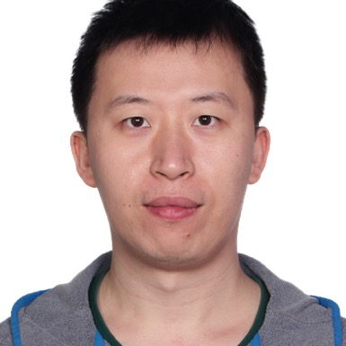
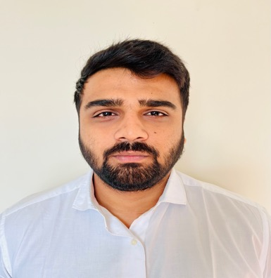

Our Team
Janvi
Patel
Scaria Ouseph Kurian
Fangji Chen
Project Lead / Communicator
Developer
Analyst

Slide 3

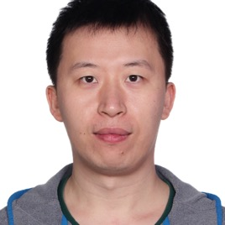
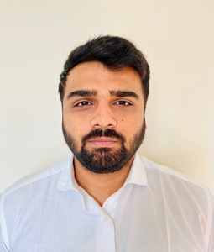
Who we are
I have a Bachelor of Computer Science degree from GTU. Prior to the Big Data Analysis program at Georgian College, I was a software developer. In terms of skills, I have high communication and organization with intermediate level experience in Python, Power BI, Machine Learning, and Deep Learning. I look forward to this project and our future weeks together.
I have a bachelor's degree in electronic information engineering and have 10 years of working experience in software engineering, data mining, and machine learning after graduating. I'm glad to work on this project and move forward with the group.
I have a Bachelor’s degree in computer science and a postgraduate program in Big Data Analytics and now I’m pursuing Artificial intelligence at Georgian college. I have an intermediate level experience in Power BI, Machine Learning, and Python. I’m glad to work on this project and move forward with this group.

Slide 4
Project Summary
The smart beach project is a three year pilot project that will provide swimmers with up-to-date information on water conditions.
The general project agenda is to use buoy(National oceanic and atmospheric administration) data and camera images to predict future water conditions.
There are 3 questions provided by MIC to the whole team of the which AI team will be working on the following question.
Predict the wave conditions and current visible in the camera images, as well the number and distribution of people on the beach and in the water.

Slide 5
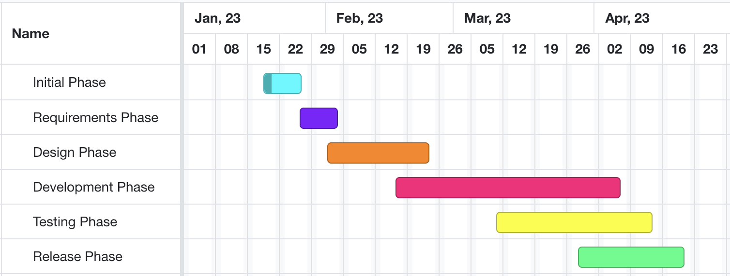
High-level GANTT Chart

Slide 6
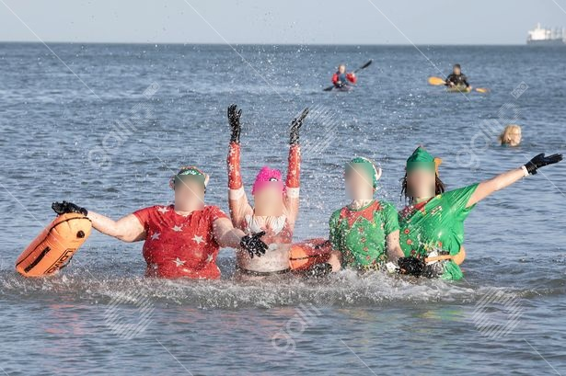
Image Anonymizing
Gallio
One day Subscription($8.00).
Results.

Slide 7
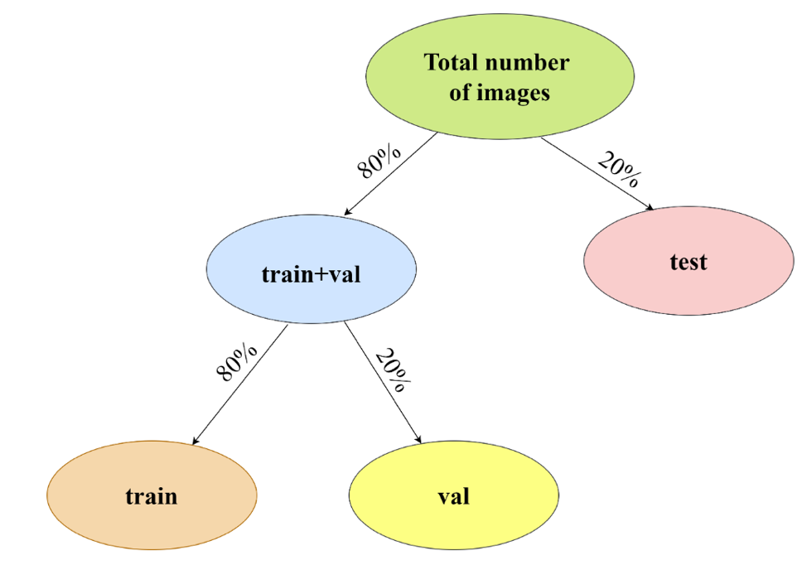
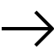
Additional activities since last report
Work:
Classification model for images.
Vgg9 was used for classification.
Transfer learning used to training the model.
Notes:
Padrinan, Miguel (n.d.). Email blocks on Gray Surface. Accessed on January 16th, 2023 from https://www.pexels.com/photo/email-blocks-on-gray-surface-1591062/

Slide 8
Communication plan:
Project: MIC at Bruce Beach
Choose the best reliable model to apply as an agent to count people onshore and inshore from camera images
Communication Goals: Keep group members informed of progress along the way and the results of the research
The progress of building the baseline
The progress of training the model
Content: discuss the research progress and challenges
Period: every two days
Methods: through Microsoft Teams Chat
Audience: required researchers and developers
Notes:
Olexa, Peter (n.d.) A Person Making a Schedule. Accessed on January 18th, 2023 from https://www.pexels.com/photo/a-person-making-a-schedule-14299948/

Slide 9
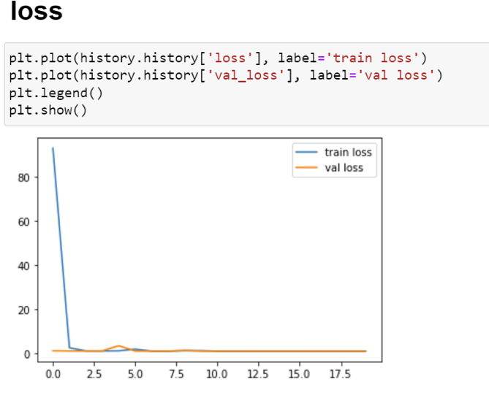
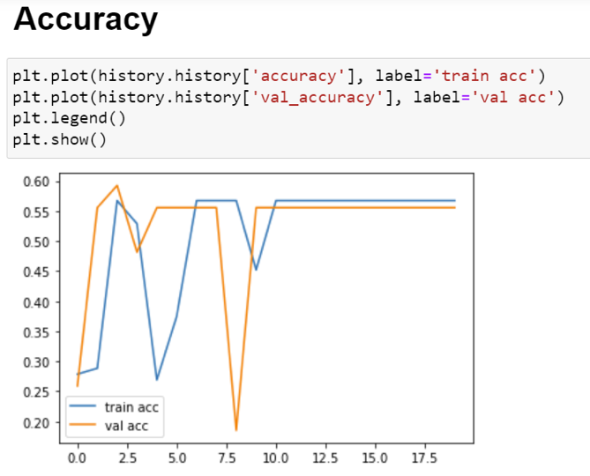
Individual Status Report - Janvi:
Classification model VGG9.
Structure of train_test chosen 80-20.
Will have to increase the accuracy of the model.
Testing required.
Notes:
Olexa, Peter (n.d.) A Person Making a Schedule. Accessed on January 18th, 2023 from https://www.pexels.com/photo/a-person-making-a-schedule-14299948/

Slide 10
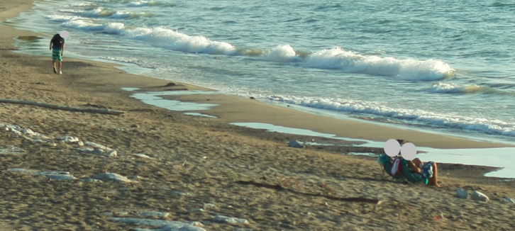
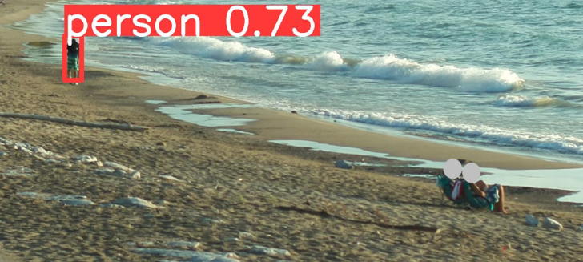
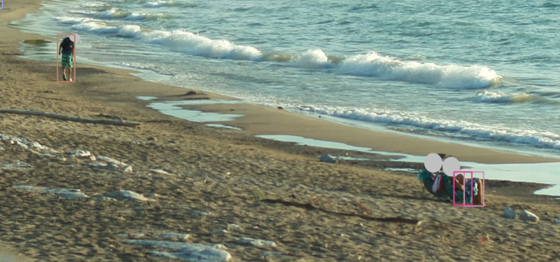
Individual Status Report – Fangi
Potential difficulties of people counting with anonymized images
InsightFace:0
YOLOv8s:1
ResNet:3
with leg pattern

Slide 11
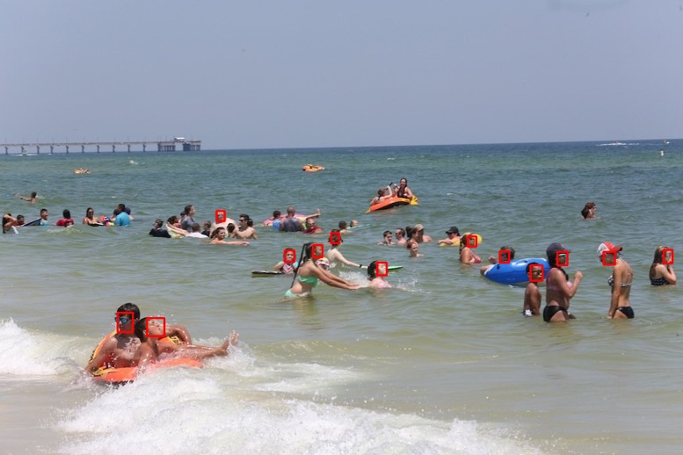
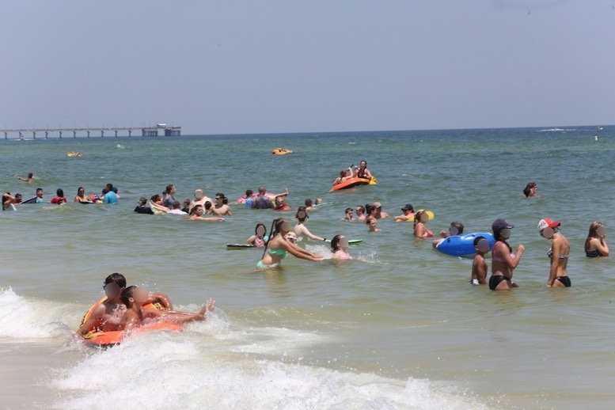
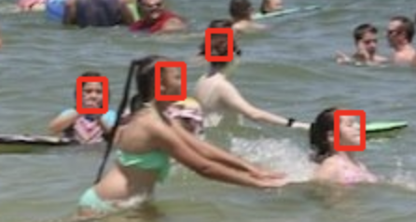
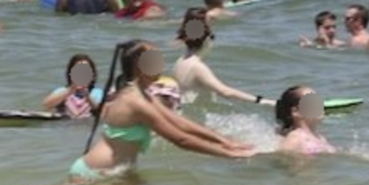
Individual Status Report – Fangi
Anonymizing with face detection
If we don’t have body patterns but heads, we may lose accuracy.
Then this is an anonymizing practice with face detection outputs, as an option.
* https://github.com/franciszero/csp.pytorch
Notes:
Olexa, Peter (n.d.) A Person Making a Schedule. Accessed on January 18th, 2023 from https://www.pexels.com/photo/a-person-making-a-schedule-14299948/

Slide 12
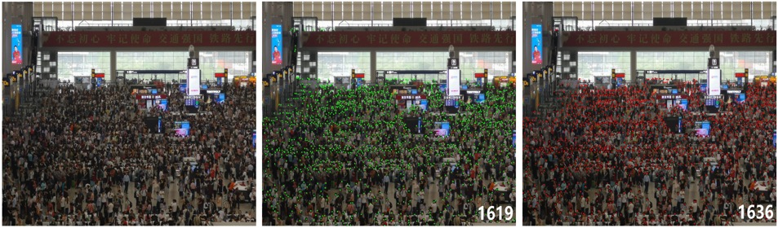
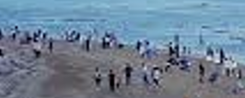
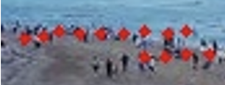
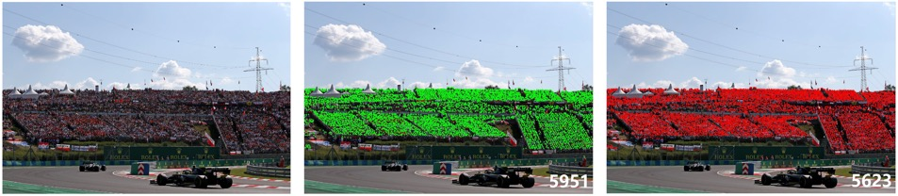
Individual Status Report – Fangi
An implementation of Crowd Counting with P2PNet – head patterns
This works for crowd counting but is applicable to limited scenarios
* https://github.com/franciszero/CrowdCounting-P2PNet
Notes:
Olexa, Peter (n.d.) A Person Making a Schedule. Accessed on January 18th, 2023 from https://www.pexels.com/photo/a-person-making-a-schedule-14299948/

Slide 13
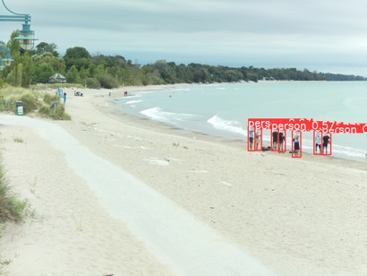
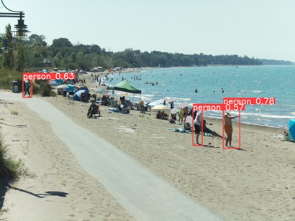
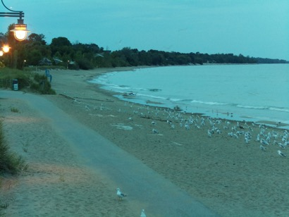
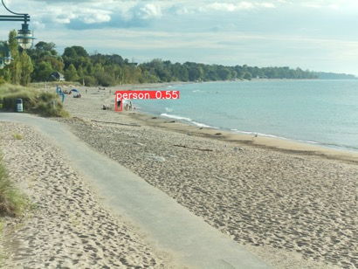
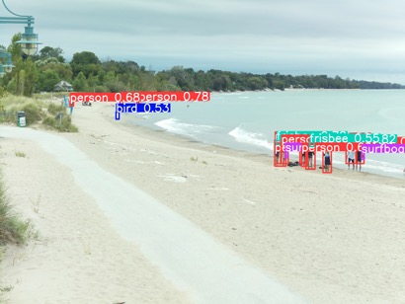
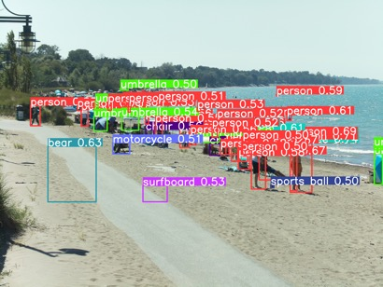
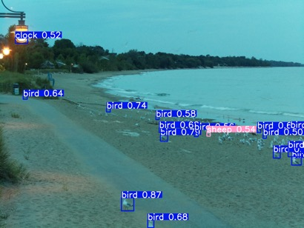
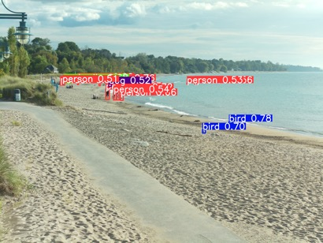
Individual Status Report – Fangi
Small object detection with SAHI+YOLOX
YOLOv5s
YOLOv5s
+ SAHI
* https://huggingface.co/spaces/fcakyon/sahi-yolov5

Slide 14
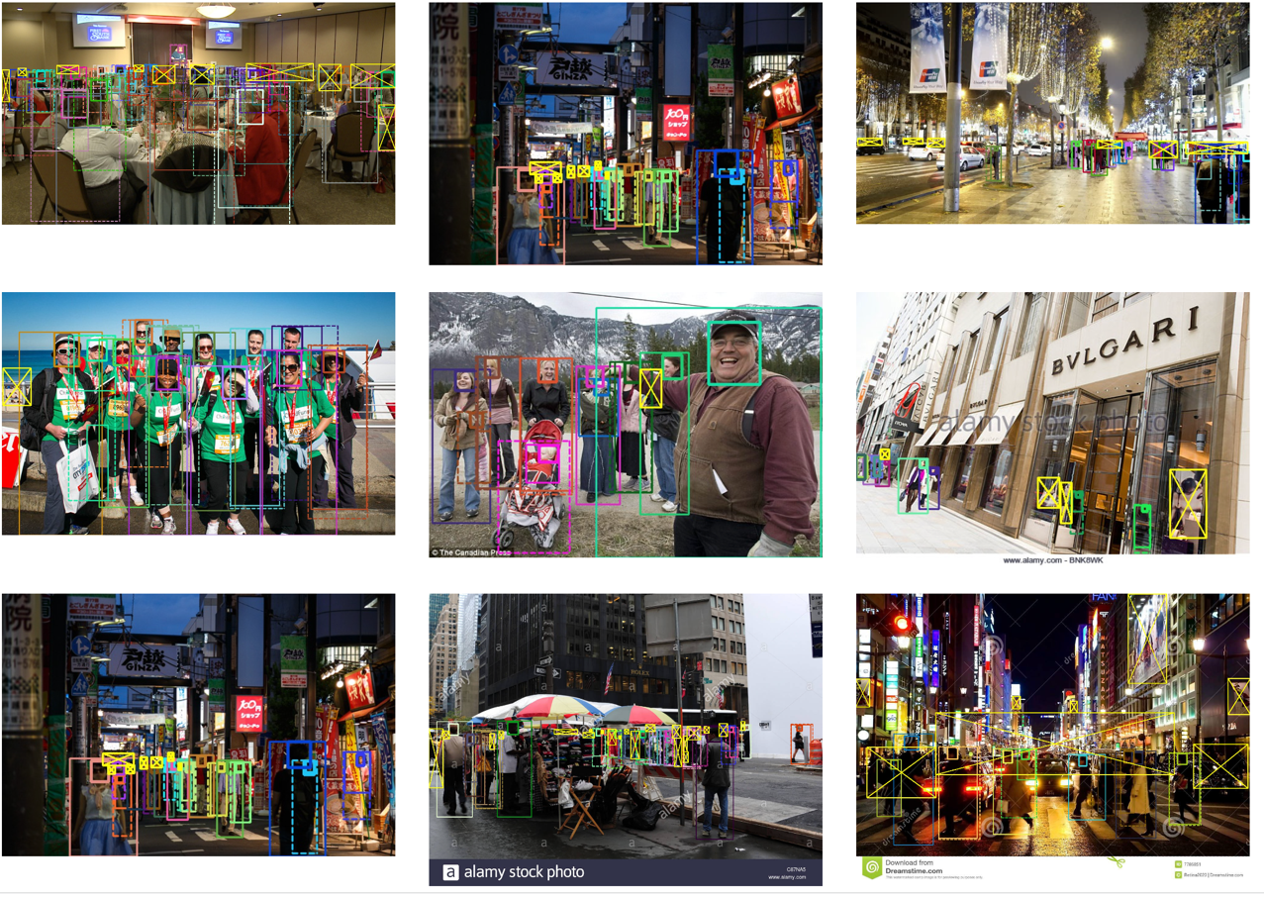
Individual Status Report – Fangi
People counting: dataset and benchmark – head patterns are important
CrowdHuman is a benchmark dataset to better evaluate detectors in crowd scenarios. The CrowdHuman dataset is large, rich-annotated and contains high diversity. CrowdHuman contains 15000, 4370 and 5000 images for training, validation, and testing, respectively. There are a total of 470K human instances from train and validation subsets and 23 persons per image, with various kinds of occlusions in the dataset. Each human instance is annotated with a head bounding-box, human visible-region bounding-box and human full-body bounding-box. We hope our dataset will serve as a solid baseline and help promote future research in human detection tasks.
http://www.crowdhuman.org/

Slide 15
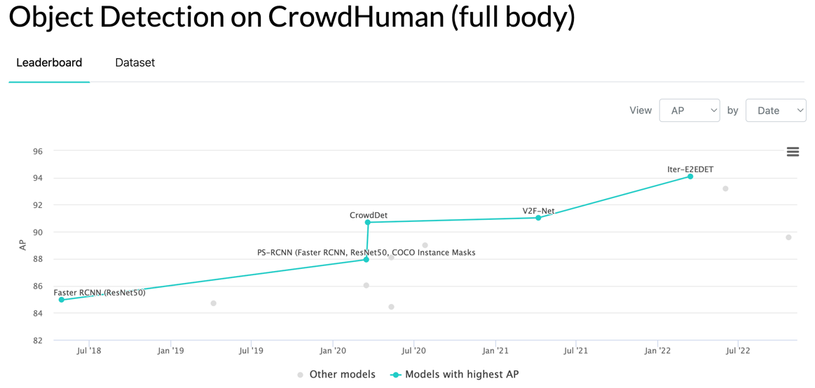
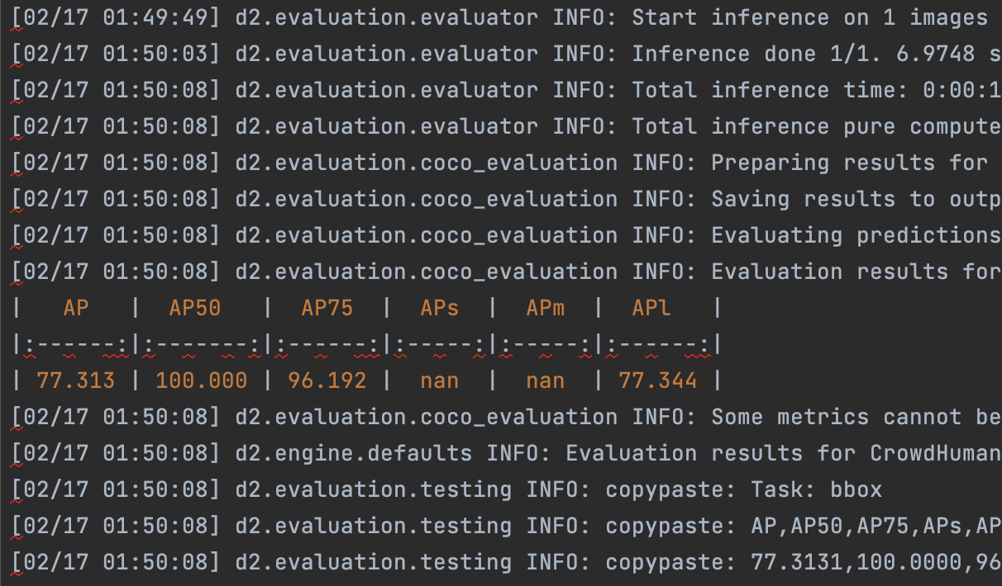
Individual Status Report – Fangi
People counting with Detectron2 Model Zoo APIs
Still working on this candidate
https://paperswithcode.com/sota/object-detection-on-crowdhuman-full-body
https://github.com/facebookresearch/detectron2/blob/main/MODEL_ZOO.md
https://github.com/franciszero/Iter-E2EDET.git

Slide 16
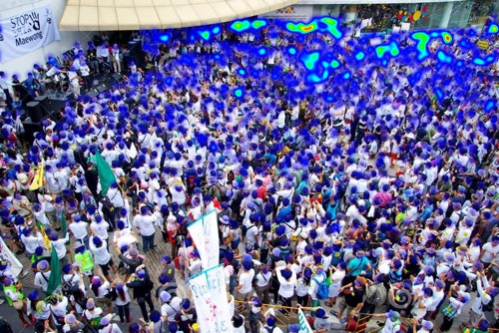
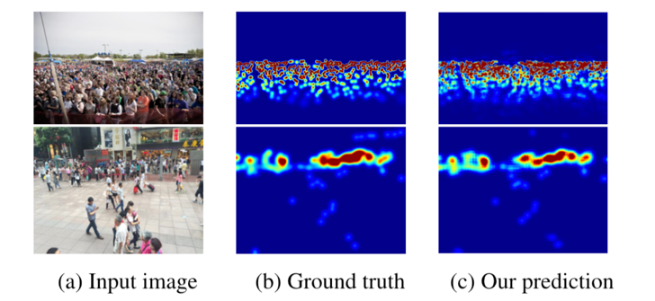
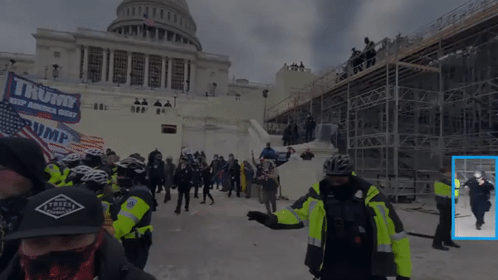
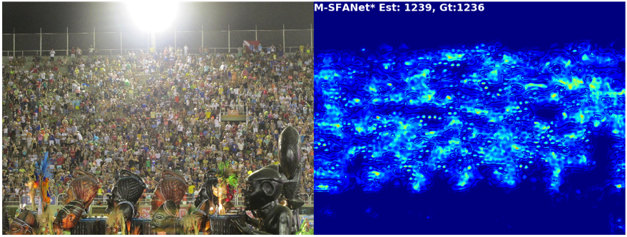
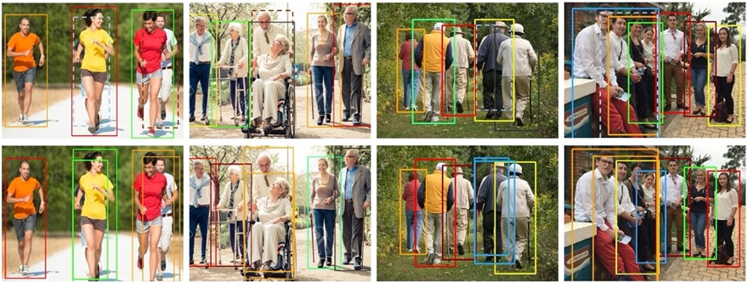
Individual Status Report – Fangi
People counting: other potential options
https://github.com/gpspelle/Crowd-Counting.git
** https://github.com/weizheliu/Context-Aware-Crowd-Counting.git
https://github.com/zhiqic/rethinking-counting
https://github.com/Pongpisit-Thanasutives/Variations-of-SFANet-for-Crowd-Counting
*** https://github.com/megvii-model/CrowdDetection

Slide 17
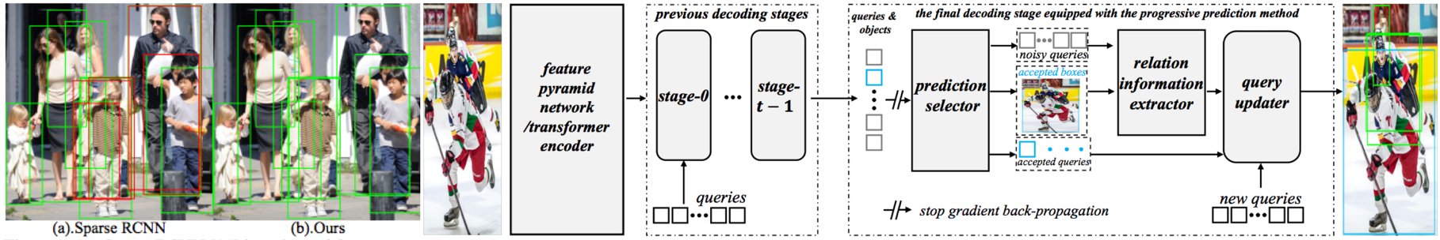
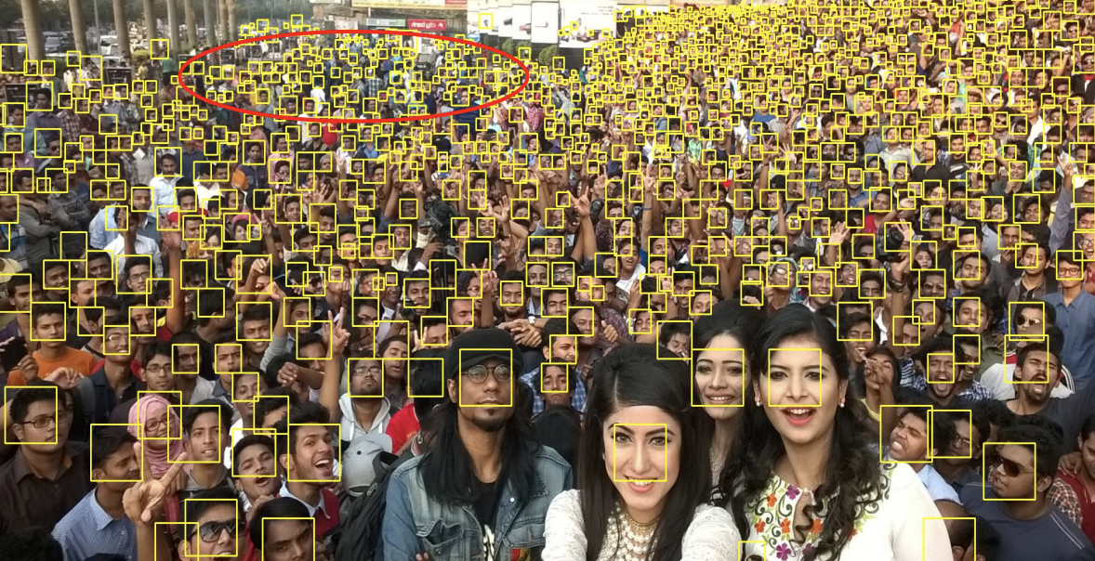
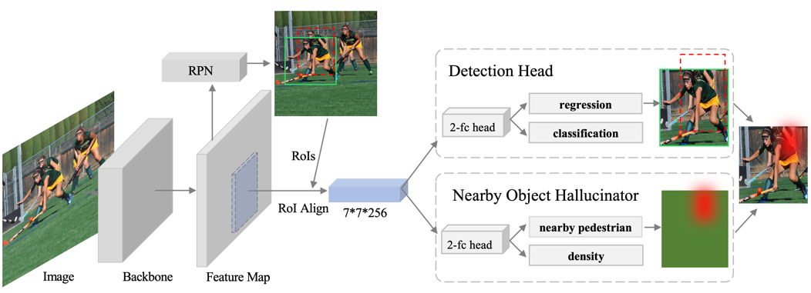
Individual Status Report – Fangi
People counting: other potential options
https://github.com/franciszero/Iter-E2EDET
* https://github.com/val-iisc/lsc-cnn
** https://github.com/franciszero/PedestrianDetection-NohNMS.git
Platform: https://github.com/facebookresearch/detectron2
Dataset: http://www.crowdhuman.org/
End-To-End People Detection in Crowded Scenes: https://www.youtube.com/watch?v=Nl2fBKxwusQ

Slide 18
Activities to be Completed before Next report:
Testing classification model.
Working on better accuracy of VGG19.
Image segmentation on people counting if necessary
Discussing if it is a good option to complete our anonymizing task
EDA on inshore wave data at Bruce Beach
Notes:
Olexa, Peter (n.d.) A Person Making a Schedule. Accessed on January 18th, 2023 from https://www.pexels.com/photo/a-person-making-a-schedule-14299948/

Slide 19
Thank you!
Questions?
Notes:
Image: Leloo, The first (2022) https://www.pexels.com/photo/question-marks-on-paper-crafts-5428833/

